Slide 1
18.369: Mathematical Methods in Nanophotonics overview lecture slides (don’t get used to it: most lectures are blackboard)
Prof. Steven G. Johnson
MIT Applied Mathematics

Slide 2
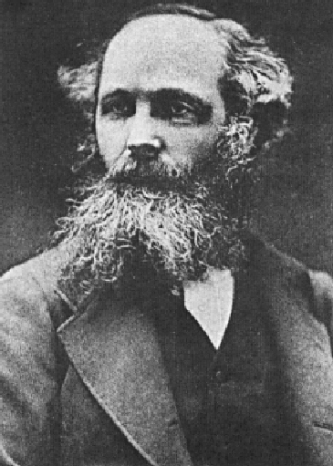
Maxwell’s Equations
Gauss:
constitutive
relations:
ε₀E = D – P
Ampere:
H = B/μ₀ – M
James Clerk Maxwell
1864
Faraday:
electromagnetic fields:
E = electric field
D = displacement field
H = magnetic field / induction
B = magnetic field / flux density
sources: J = current density
ρ = charge density
material response to fields:
P = polarization density
M = magnetization density
constants: ε₀, μ₀ = vacuum permittivity/permeability
c = vacuum speed of light = (ε₀ μ₀)^{-1/2}

Slide 3
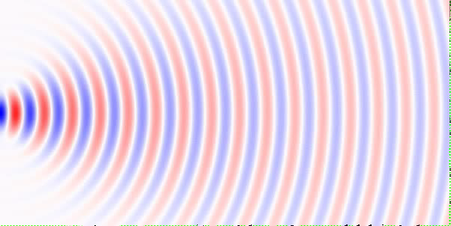
Light is a Wave (and a quantum particle)
color ~ wavelength λ ≈ 500nm for visible light
(a little laser)
wave
spreading:
diffraction
–
+
speed c ≈ 186,000 miles/sec
out-of-plane electric field

Slide 4
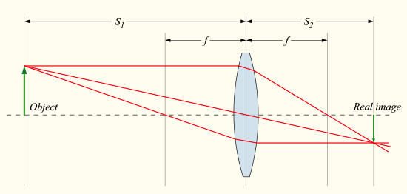
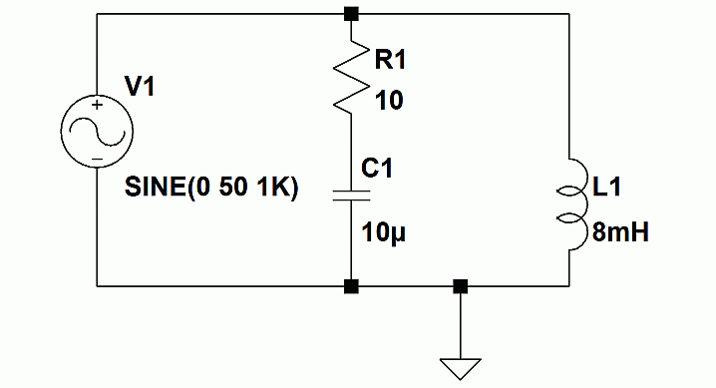
When can we solve this mess?
• Very small wavelengths: ray optics
• Very large wavelengths:
quasistatics (8.02)
& lumped circuit models (6.002)
[ wikipedia ]
[ homestead.com ]
• Wavelengths comparable to geometry?
— handful of cases can be ~solved analytically:
planes, spheres, cylinders, empty space (8.07, 8.311)
— everything else just a mess for computer…?

Slide 5
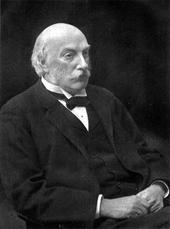
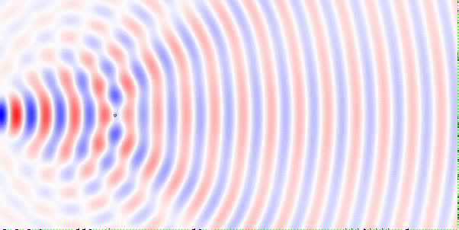
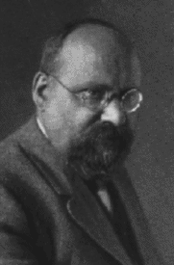
Waves Can Scatter
small particles:
Lord Rayleigh (1871)
why the sky is blue
here: a little circular speck of silicon
checkerboard pattern: interference of waves
traveling in different directions
scattering by spheres:
solved by Gustave Mie (1908)

Slide 6
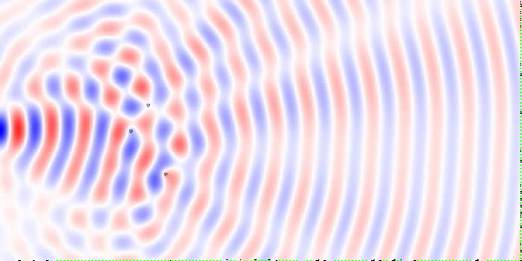
Multiple Scattering is Just Messier?
here: scattering off three specks of silicon
can be solved on a computer, but not terribly interesting…

Slide 7
An even bigger mess? zillons of scatterers
Blech, light will just scatter like crazy
and go all over the place … how boring!

Slide 8
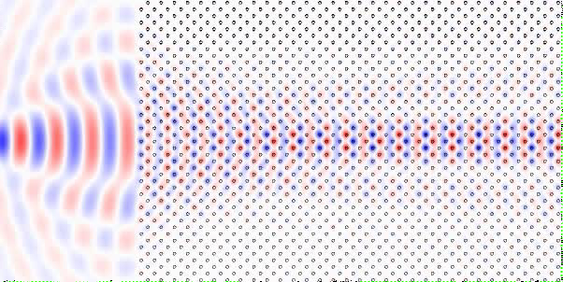
Not so messy, not so boring…
the light seems to form several coherent beams
that propagate without scattering
… and almost without diffraction (supercollimation)

Slide 9
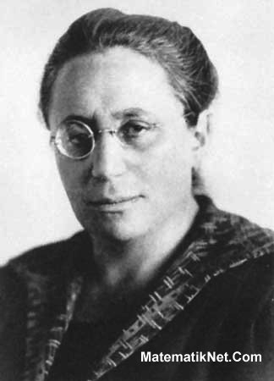

…the magic of symmetry…
Noether’s theorem:
symmetry = conservation laws
In this case, periodicity
= conserved “momentum”
= wave solutions without scattering
[ Bloch waves ]
Felix Bloch
(1928)
[ Emmy Noether, 1915 ]
Mathematically, use structure of the equations, not explicit solution:
linear algebra, group theory, functional analysis, …

Slide 10
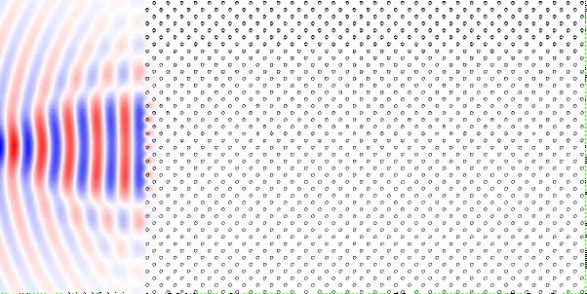
A slight change? Shrink λ by 20% an “optical insulator” (photonic bandgap)
light cannot penetrate the structure at this wavelength!
all of the scattering destructively interferes

Slide 11
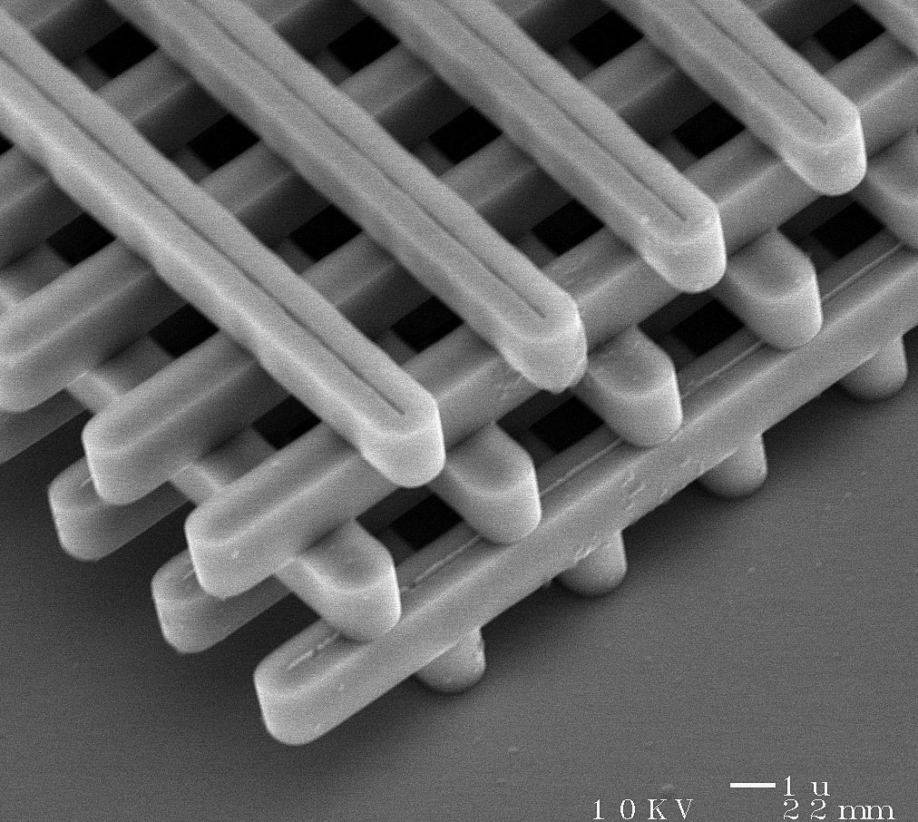
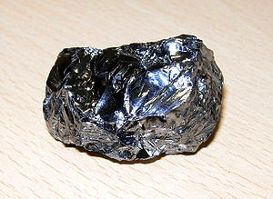
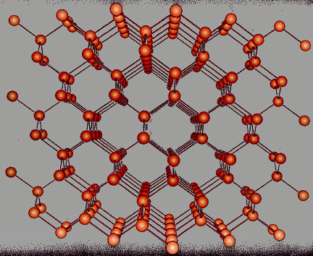
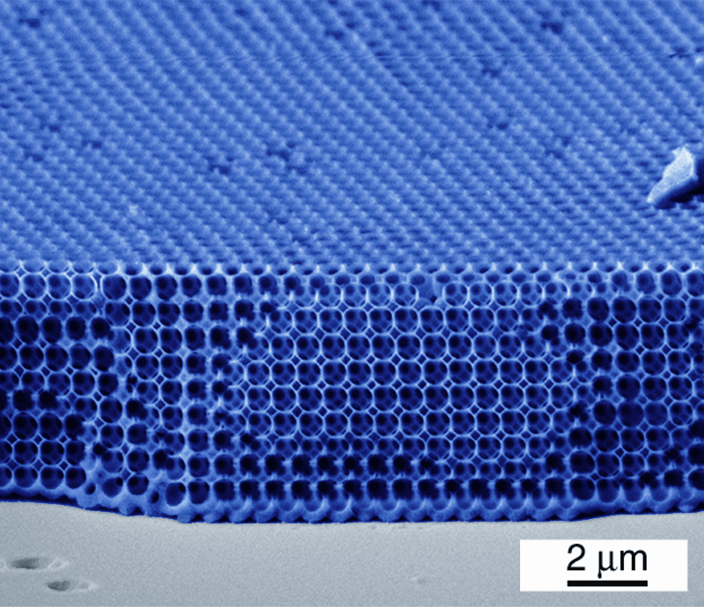
Photonic Crystals: periodic structures for light
crystalline minerals:
periodic atoms
synthetic microstructures
Some nice math to
understand this…
silicon:
…linear algebra:
[ wikipedia.org ]
(eigenproblem)
[ Lin, 1998 ]
…symmetry ⇒ group
representation theory
…computational
methods…
[ S. K. Bose, brocku.ca ]
…many open
questions…
bandgaps = insulators &
semiconductors
[ Vlasov, 2001 ]

Slide 12
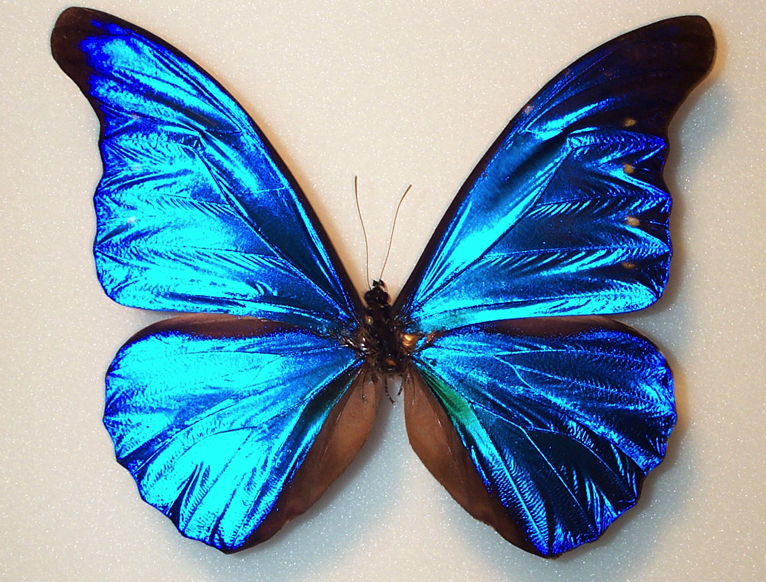
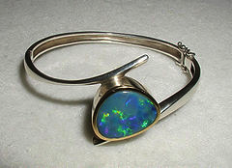
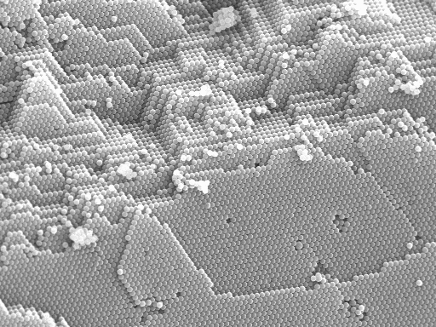
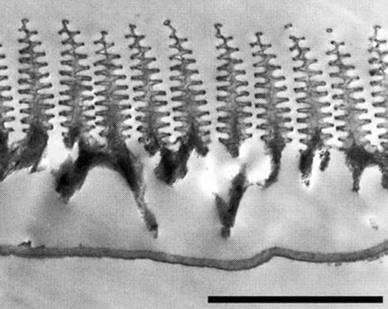
Structural Color in Nature
bandgap = wavelength-selective mirror = bright iridescent colors
morpho
rhetenor
opals
[ wikipedia ]
wing scale:
[ P. Vukosic (1999) ]
also peacocks,
beetles, …
3µm
http://www.icmm.csic.es/cefe/

Slide 13
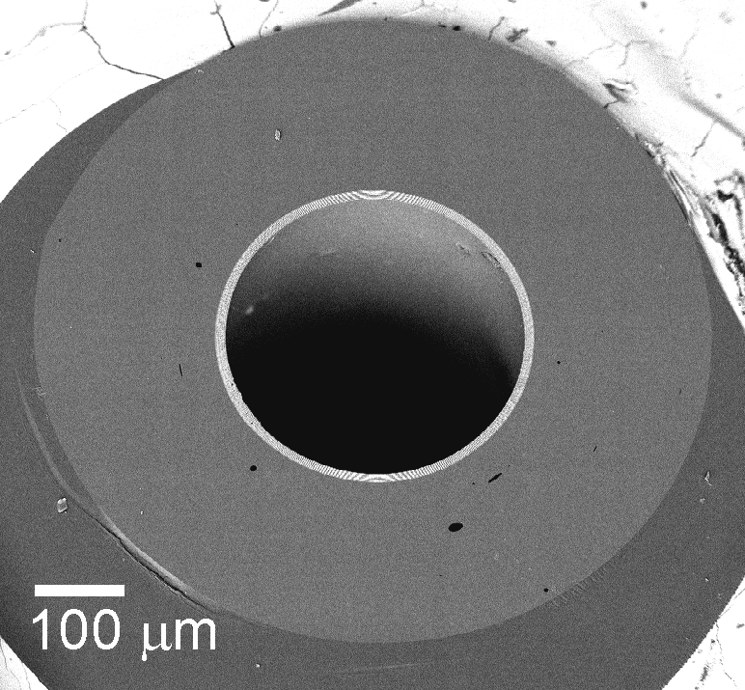
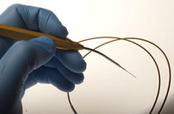
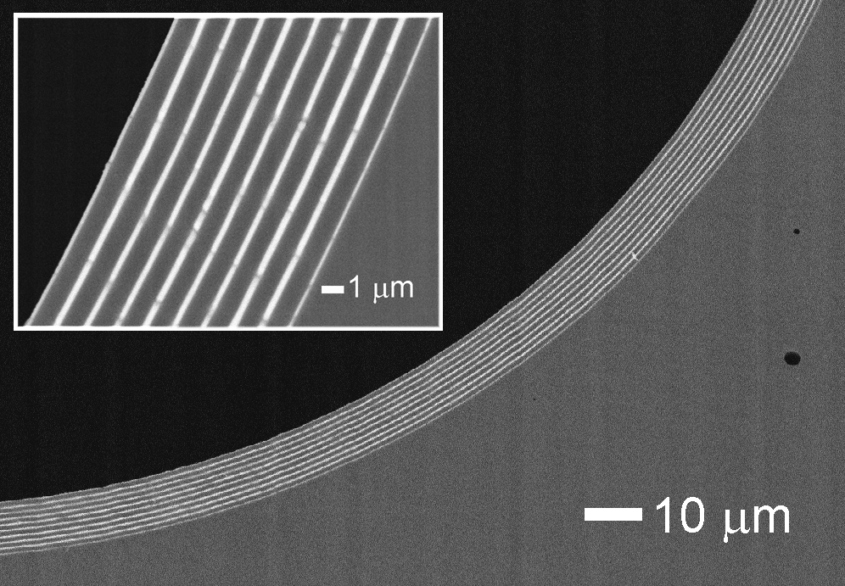
Light Confinement for Surgery
fiber cross-section
hollow
core
MIT startup: omni-guide.com
Periodic layering
confines laser light
that would vaporize glass
within a hollow core
Used for endoscopic surgery

Slide 14
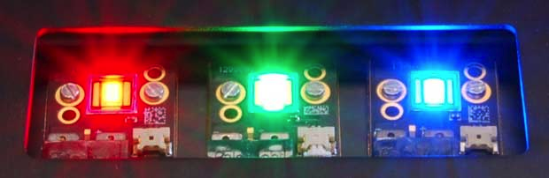
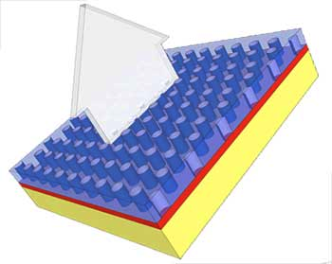
Molding Diffraction for Lighting
[ another MIT startup (by a colleague): Luminus.com ]
ultra-bright/efficient LEDs
periodic pattern gathers &
redirects it in one direction
new projection TVs,
pocket projectors,
lighting applications,
…

Slide 15
Back to Maxwell, with some simplifications
• source-free equations (propagation of light, not creation): J = 0, ρ = 0
• Linear, dispersionless (instantaneous response) materials:
P = ε₀ χ_{e} E
⇒
D = ε₀ (1+χ_{e}) E = ε₀ ε_{r} E
M = χ_{m} H
B = μ₀ (1+χ_{m}) H = μ₀ μ_{r} H
(nonlinearities very weak
in EM … we’ll treat later)
(dispersion can be negligible
in narrow enough bandwidth)
where ε_{r} = 1+χ_{e} = relative permittivity
or dielectric constant
μ_{r} = 1+χ_{m} = relative permeability
(drop r subscript)
εμ = (refractive index)²
• Isotropic materials: ε, μ = scalars (not matrices)
• Non-magnetic materials: μ = 1 (true at optical/infrared)
• Lossless, transparent materials: ε real, > 0 (< 0 for metals…bad at infrared)

Slide 16
Simplified Maxwell
• Linear, time-invariant system:
⇒ look for sinusoidal solutions E(x,t) = E(x)e^{–iωt}, H(x,t) = H(x)e^{–iωt}
(i.e. Fourier transform)
[ note: real materials have
dispersion: ε depends on ω
= non-instantaneous response ]
… these, we can work with

Slide 17
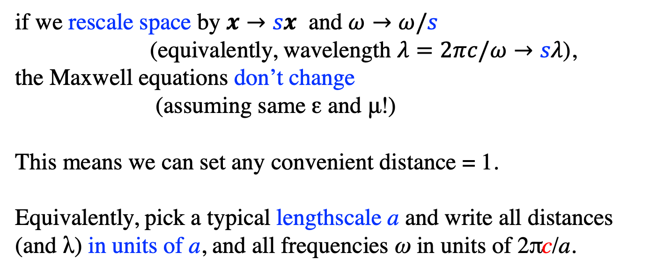
Dimensionless Maxwell
rescale the units so that ε₀ and μ₀ both = 1 (c = 1)
Scale-invariance:
if we rescale space by $x→sx$ and $ω→ω/s$
(equivalently, wavelength $λ=2πc/ω→sλ$),
the Maxwell equations don’t change
(assuming same ε and μ!)
This means we can set any convenient distance = 1.
Equivalently, pick a typical lengthscale a and write all distances (and λ) in units of a, and all frequencies ω in units of 2πc/a.

